Slide 1
Introduction to angular
Job ready training

Slide 2
Angular Architecture and Core Concepts
Understanding Angular Component Hierarchy
Understanding Angular Module
agenda
Interpolation, expression, events and statements
Expression restrictions and recommendations
Demo and Practice
Links

Slide 3
Angular Architecture
MetaData
Module
Component { }
Module
Component { }
Module
Component { }
Module
Component { }
Template
< >
Directive
{ }
Event
Binding
MetaData
Property
Binding
Injector
Service
Component
Notes:
You write Angular applications by composing HTML templates with Angularized markup, writing component classes to manage those templates, adding application logic in services, and boxing components and services in modules.

Slide 4
Core Concepts (Data binding)
A mechanism for coordinating parts of a template with parts of a component
Binding Markup added to the template HTML.
Four forms of Databinding syntax:
Template
< >
Event
Binding
{{ value}}
<li>{{myApp.name}}</li>
<app-myApp-detail [myApp]="selectedMyApp">
</app-myApp-detail>
<li (click)="selectMyApp(myApp)"></li>
<input [(ngModel)]=“myApp.name">
[property] = “value”
MetaData
DOM
COMPONENT
Property
Binding
(event) = “handler”
[(ng-model)] = “property”
Component
Notes:
Without a framework, you would be responsible for pushing data values into the HTML controls and turning user responses into actions and value updates. Writing such push/pull logic by hand is tedious, error-prone, and a nightmare to read as any experienced jQuery programmer can attest.
Add binding markup to the template HTML to tell Angular how to connect both sides.
Data binding plays an important role in communication between a template and its component. Data binding is also important for communication between parent and child components.

Slide 5
Core Concepts (Directives)
Angular templates are dynamic. Angular renders templates, it transforms the DOM according to the instructions given by directives.
A directive is a class with a @Directive decorator.
A component is a directive-with-a-template.
@Component decorator is actually a @Directive decorator extended with template-oriented features.
Other directive types:
Structural directives - Alters layout by adding, removing, and replacing elements in DOM.
Built in structural directives
<li *ngFor="let hero of heroes"></li>
<app-hero-detail *ngIf="selectedHero"></app-hero-detail>
Attribute directives alter the appearance or behavior of an existing element.
<input [(ngModel)]="hero.name">
ngSwitch, ngStyle, ngClass are some additional directive types.
MetaData
Directive
{ }
Notes:
While a component is technically a directive, components are so distinctive and central to Angular applications that this architectural overview separates components from directives.
In templates they look like regular HTML attributes, hence the name.

Slide 6
Core Concepts (Services)
Broad Category - Includes any value, function or feature which the Angular application needs
It is typically a class with a narrow, well-defined purpose.
Examples include:
logging service
data service
message bus
tax calculator
application configuration
Anything else
Example of Service : src/app/logger.service.ts
export class Logger {
log(msg: any) { console.log(msg); }
error(msg: any) { console.error(msg); }
warn(msg: any) { console.warn(msg); }
}
Service
Notes:
Angular has no definition of a service. There is no service base class, and no place to register a service.
Component classes should be lean. They don't fetch data from the server, validate user input, or log directly to the console. They delegate such tasks to services.
A component's job is to enable the user experience and nothing more. It mediates between the view (rendered by the template) and the application logic (which often includes some notion of a model). A good component presents properties and methods for data binding. It delegates everything nontrivial to services.

Slide 7
Core Concepts (Dependency injection)
It’s a way to supply a new instance of a class with the fully-formed dependencies it requires.
Most dependencies are services
Angular uses dependency injection to provide new components with the services they need.
constructor(private service: MyAppService) { }
Injector
Service A
Service B
myAppService
Service C
Service D
GrandChild A Component { }
GrandChild A
Template < >
Notes:
When Angular creates a component, it first asks an injector for the services that the component requires.
An injector maintains a container of service instances that it has previously created. If a requested service instance is not in the container, the injector makes one and adds it to the container before returning the service to Angular.
When all requested services have been resolved and returned, Angular can call the component's constructor with those services as arguments. This is dependency injection.
Points to remember about dependency injection:
Dependency injection is wired into the Angular framework and used everywhere.
The injector is the main mechanism.
An injector maintains a container of service instances that it created.
An injector can create a new service instance from a provider.
A provider is a recipe for creating a service.
Register providers with injectors.

Slide 8
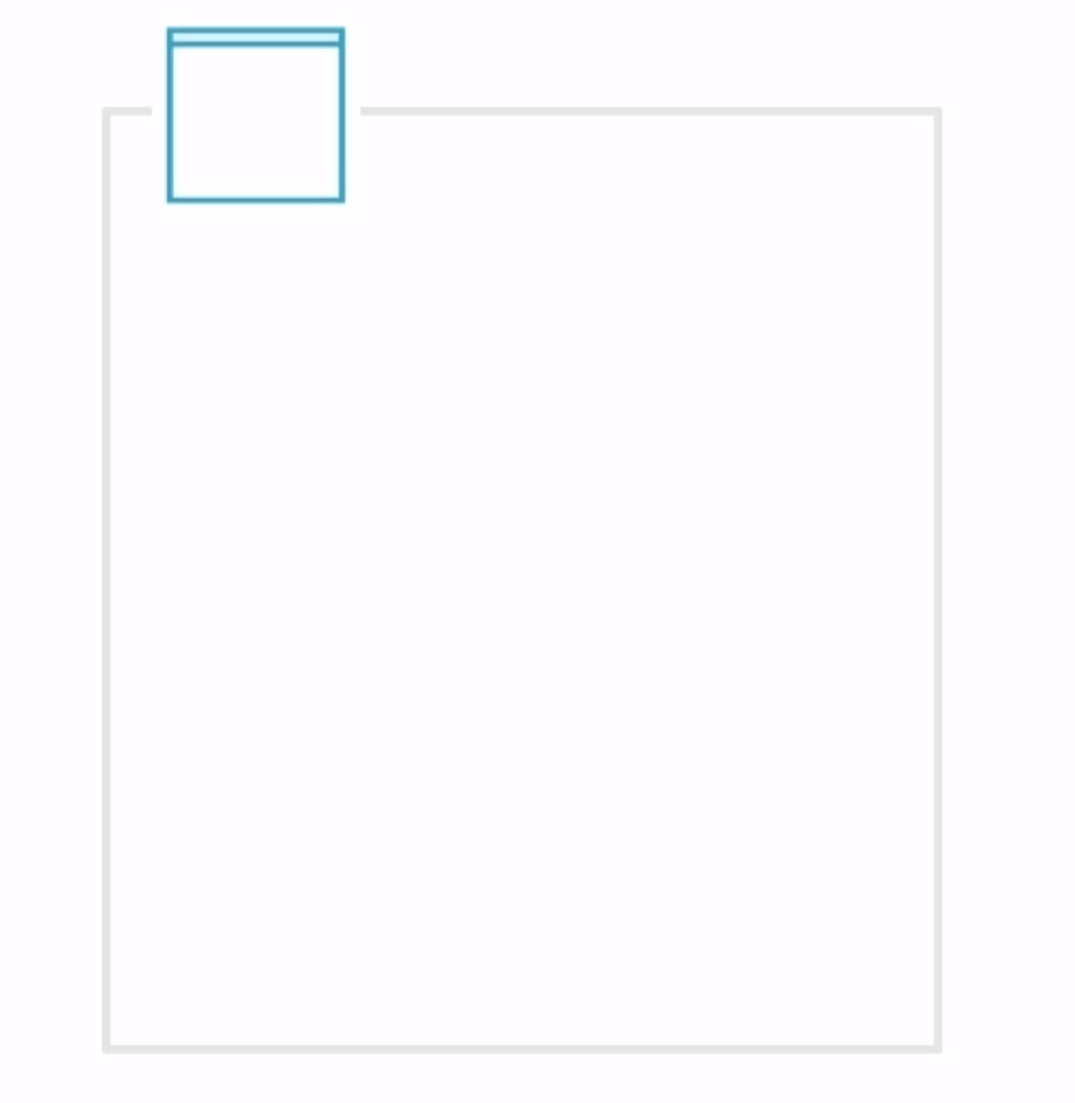
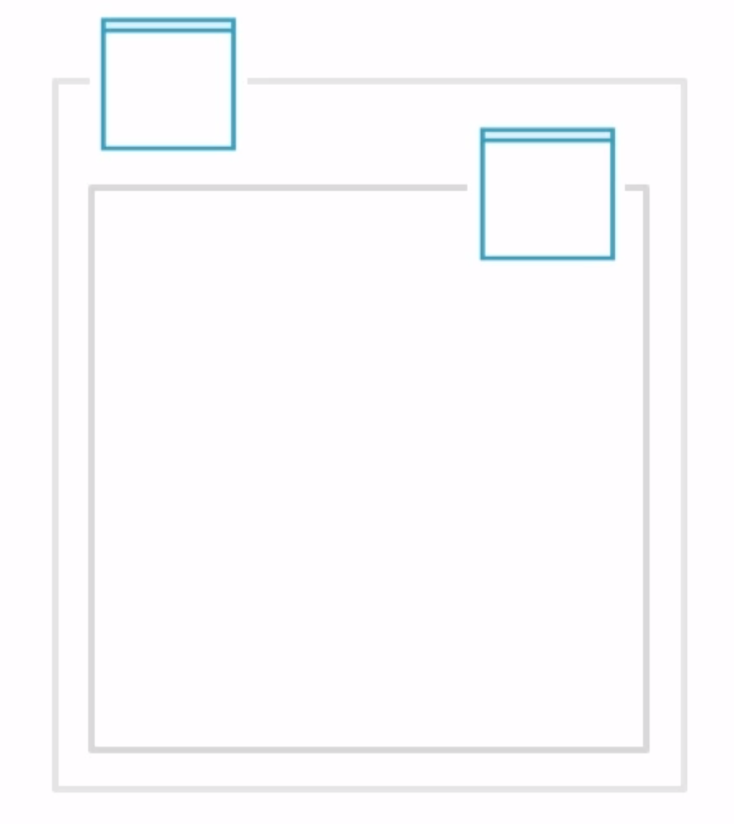
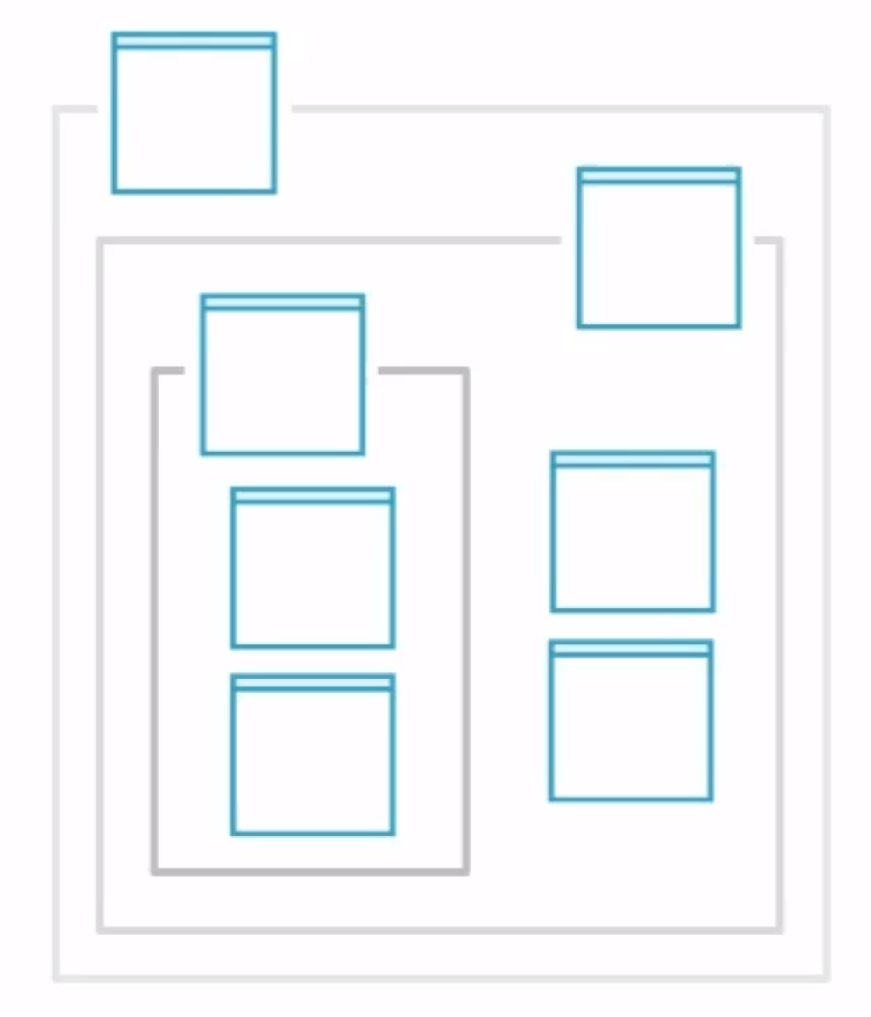
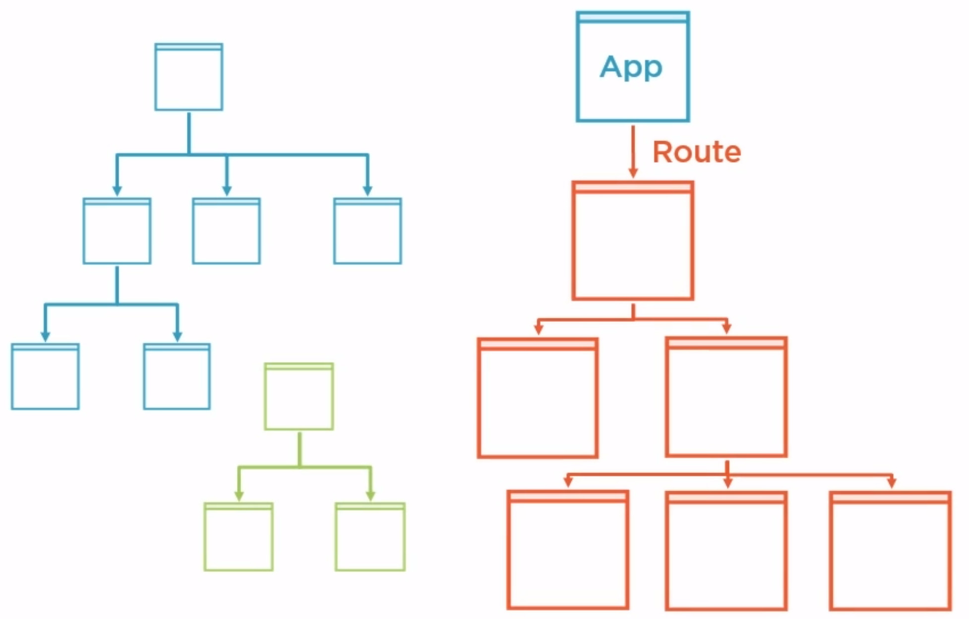
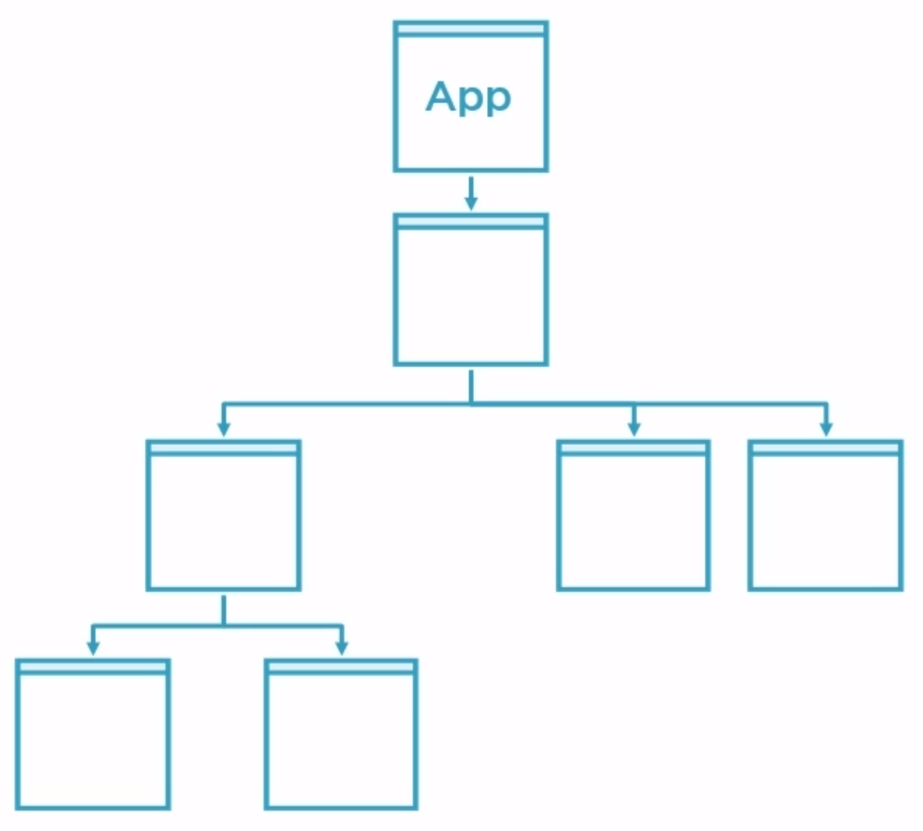
Understanding Angular Component Hierarchy
Router routes to App Component
Smaller nested components loaded
Root APP Component
Router loads newer components based on new routes
Notes:
Root Component is added first
Angular router takes a look at URL and identifies I have a component that matches that route and loads that component
Components template is then loaded in the browser
Components may then load some data from the server and give it to the template to be displayed
Of course if this page is complex then it is composed of lots of smaller components and those components can have other smaller components
This ends up then creating a tree and now imagine when user navigates to another url within the application then basically we start a new tree then the app components sees the new route and then loads the newer corresponding component and all its sub component

Slide 9
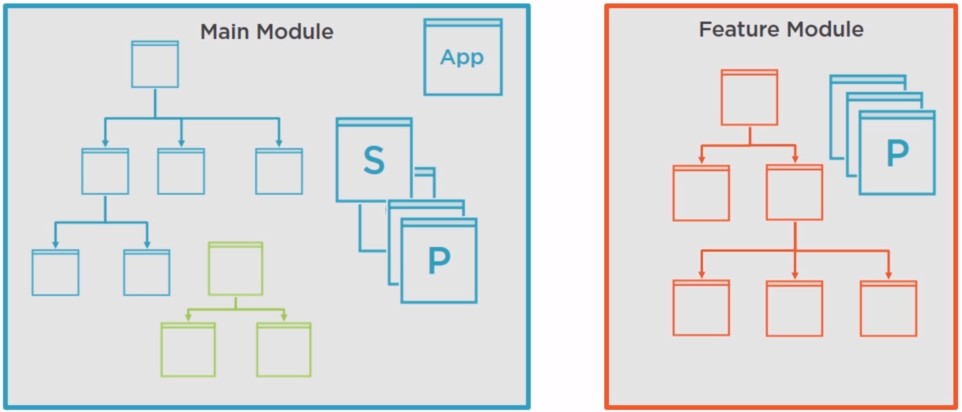
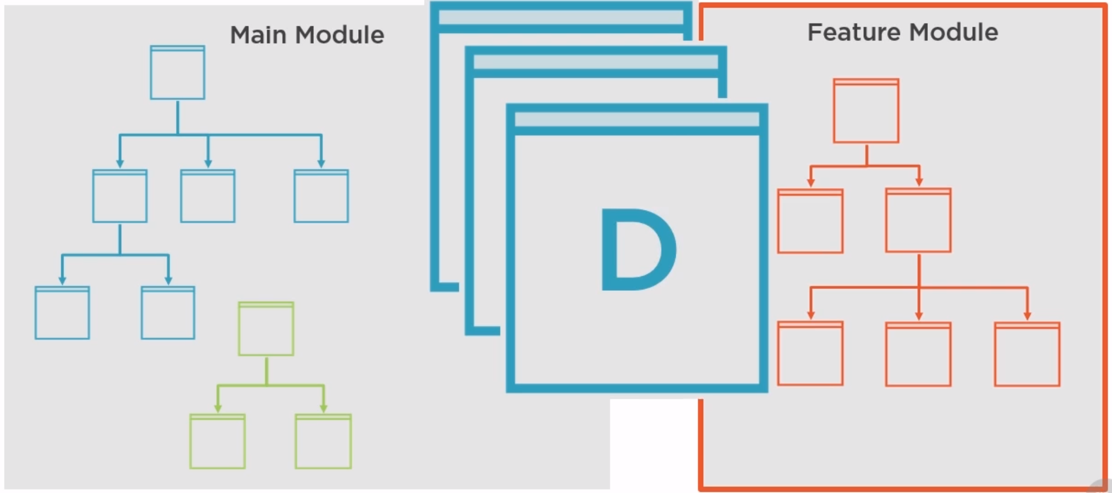
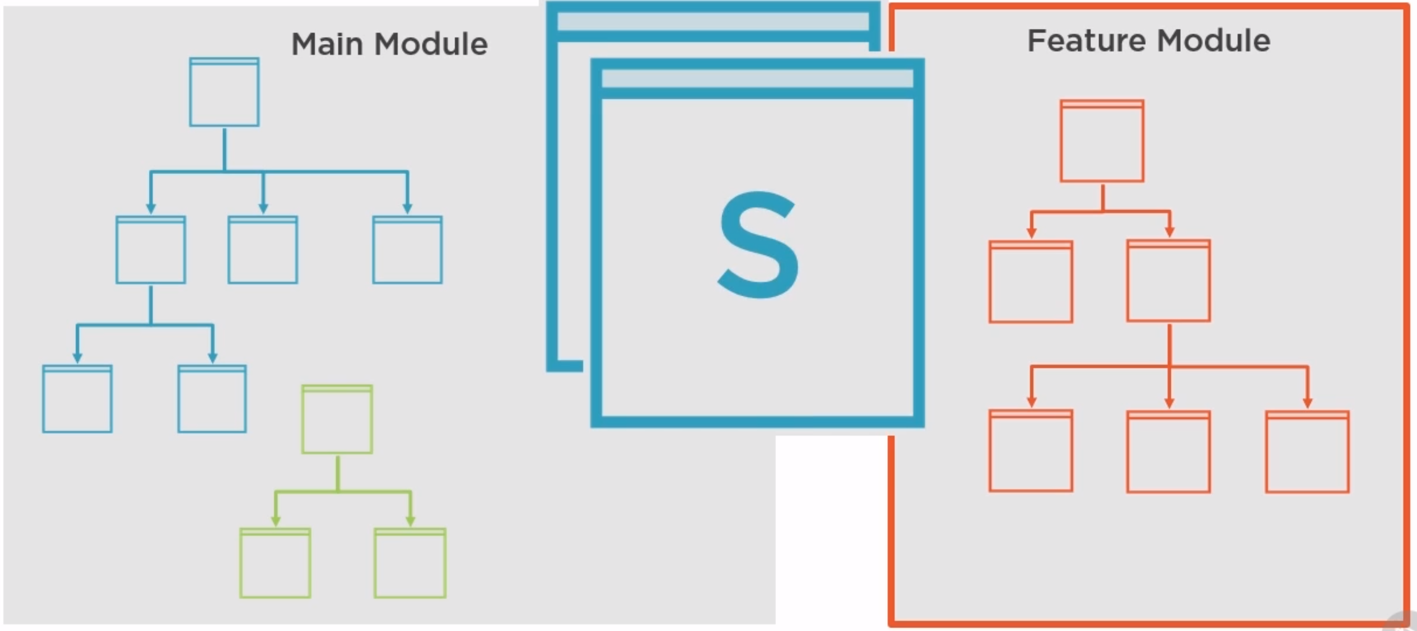
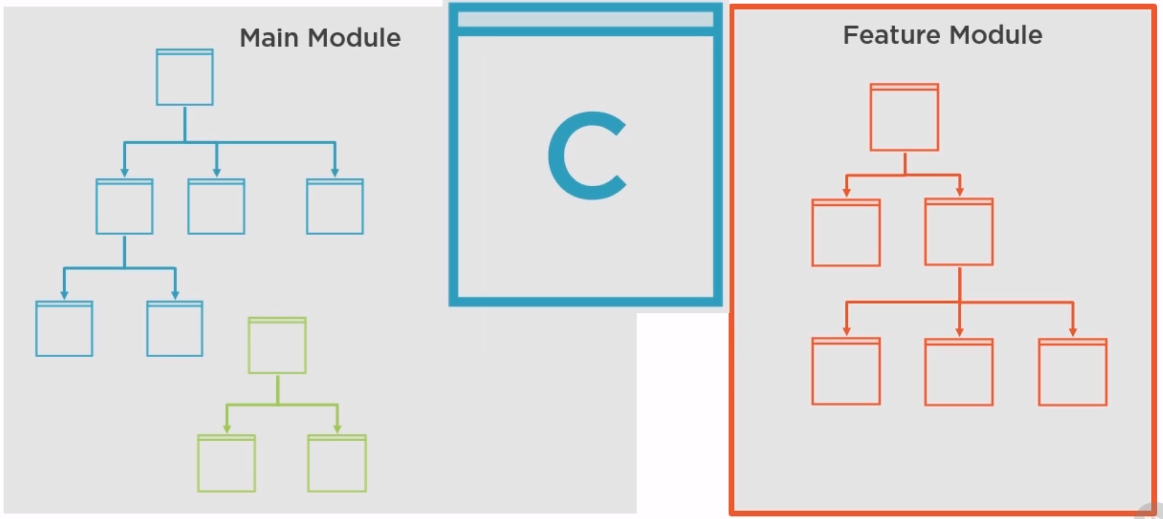
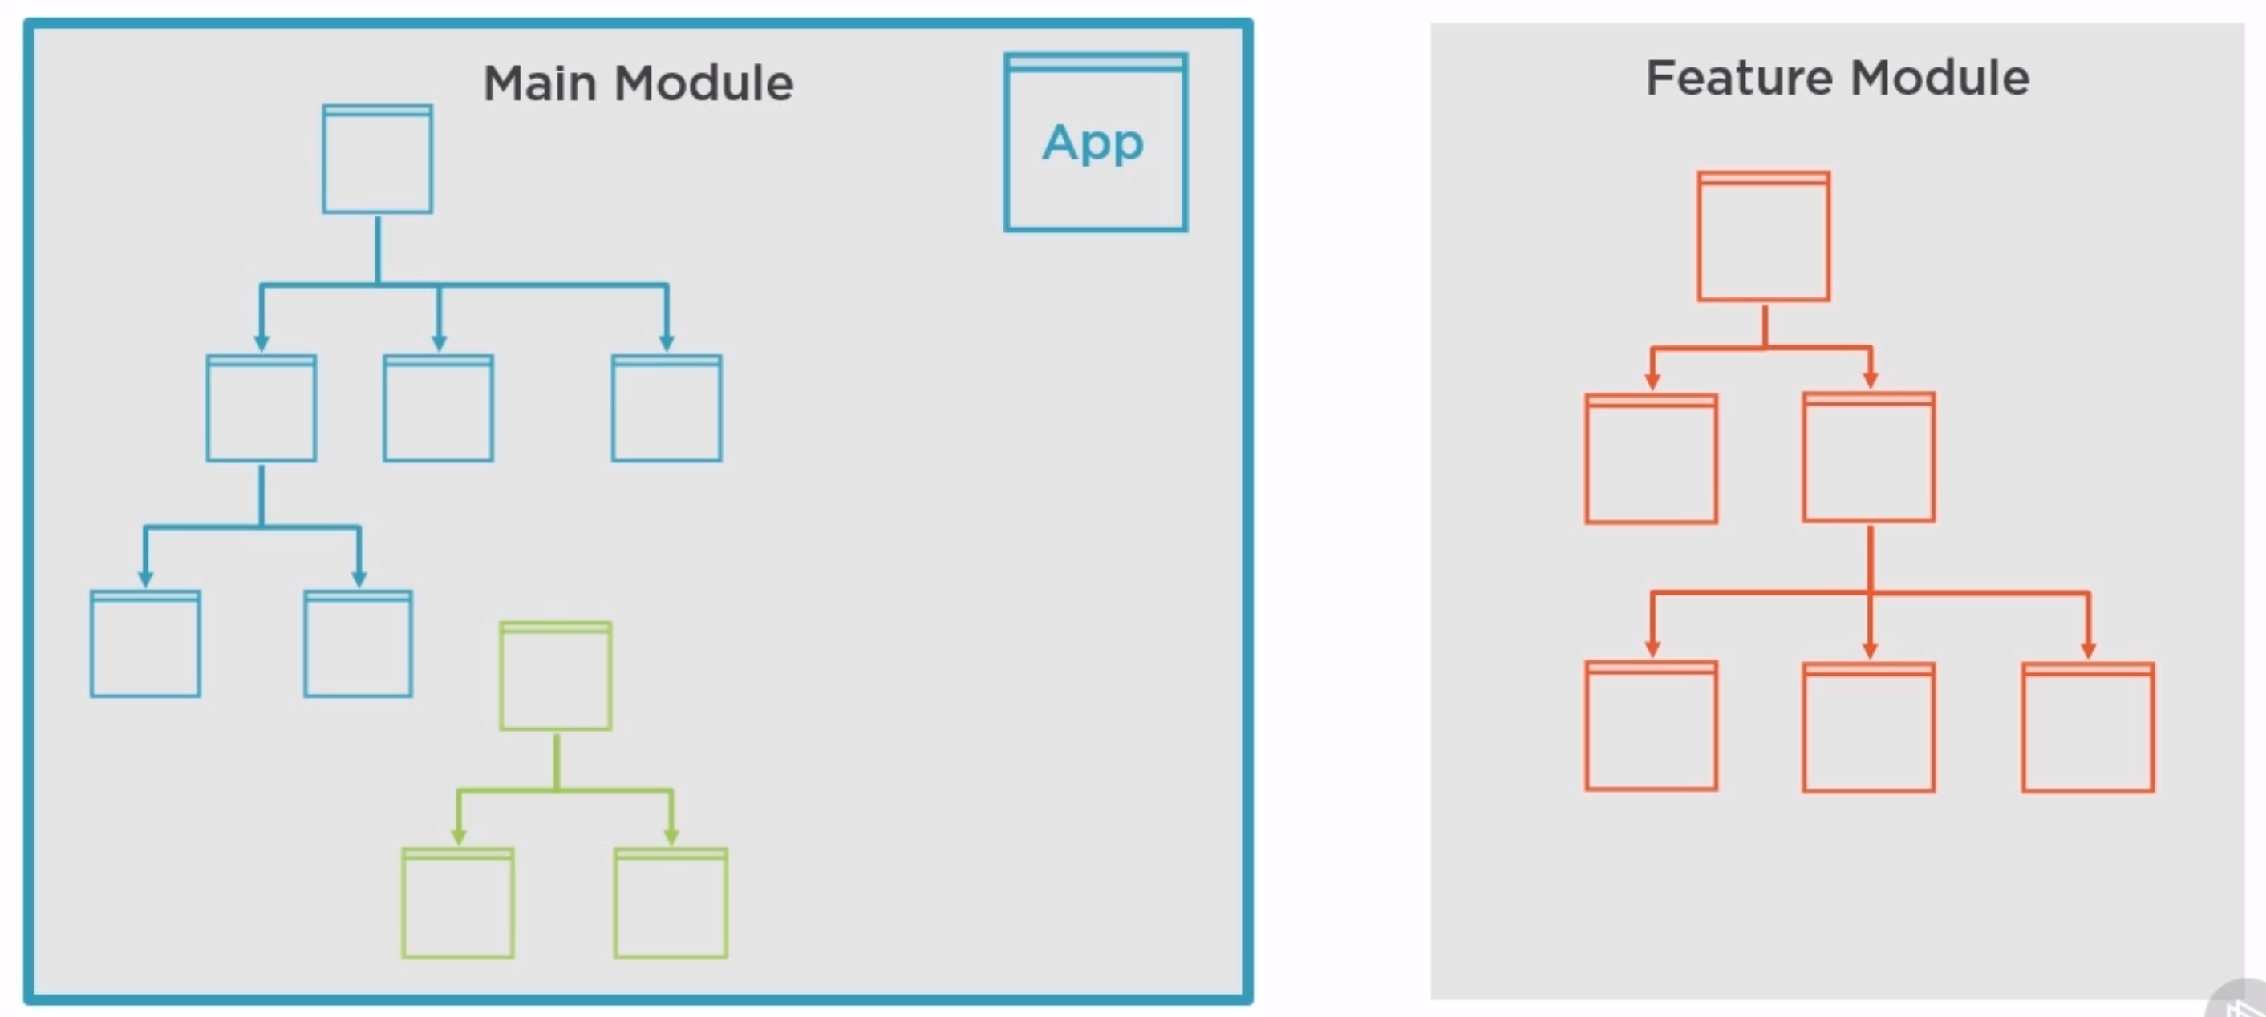
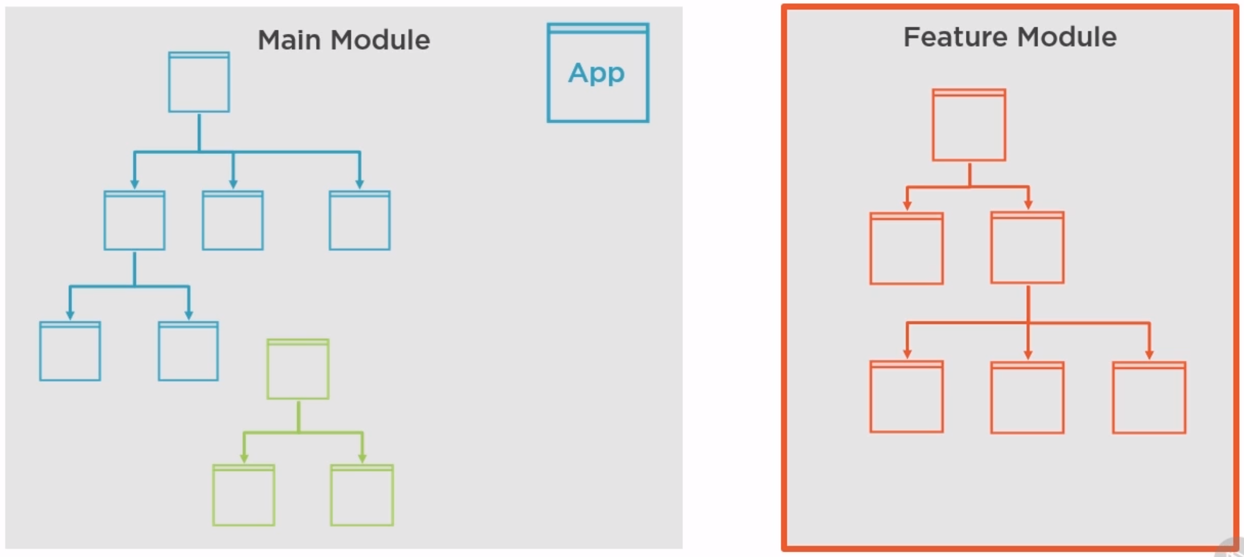
Understanding Angular Module
Notes:
As the application becomes bigger and bigger this could have become a lot of things to load into the memory. This is where Angular Module Kicks in
Angular modules are meant to be containers that will group all of the routes, component trees, and there corresponding bits of code that can be loaded independently with each other.
So when the user visits only Main Module the files of the corresponding section is only loaded and bowser will load the other section of files when the other section is loaded.
One important high level concept regarding module is that how modules are used to make directives, components and services available to your modules.
Component ,Directive, Services and Pipes are created and registered in the module. With all of these they are available in the module.
That’s true about all except services as Services are providers that gets registered in the root injector so they are available across angular modules.

Slide 10
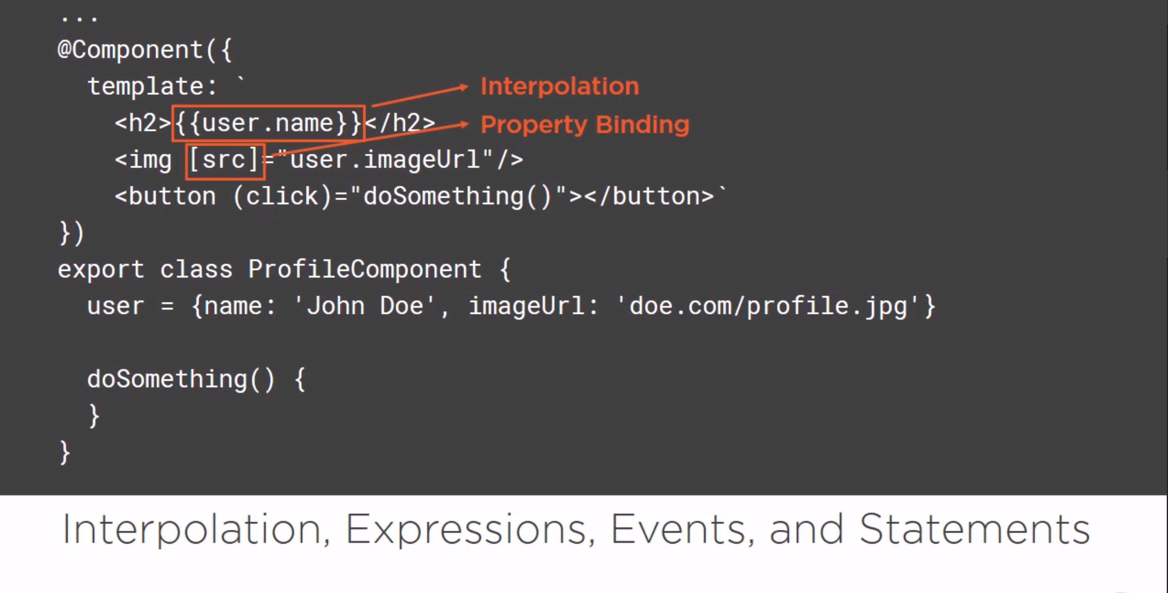
Notes:
Interpolation and Property Bindings
Expressions are used for binding
Event bindings and statements

Slide 11
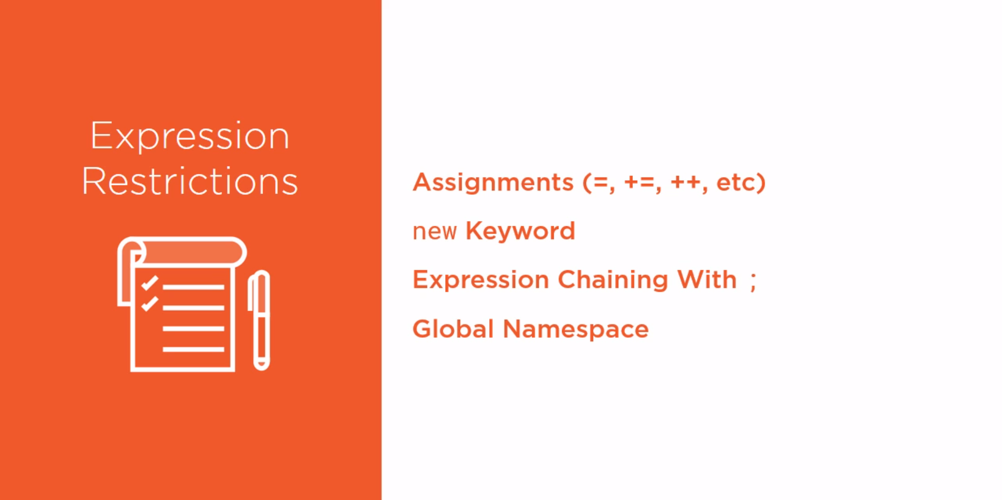

Slide 12
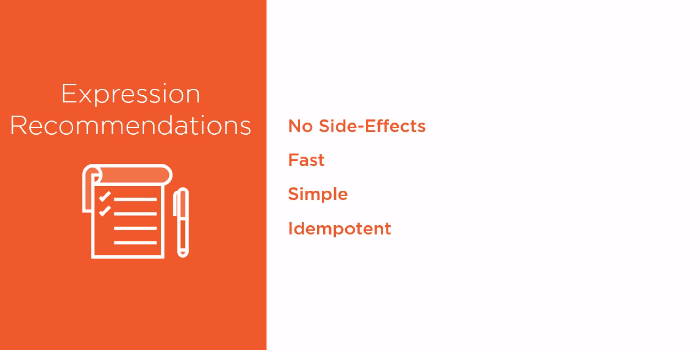
Notes:
Idempotent: Means the value doesnot changes

Slide 13
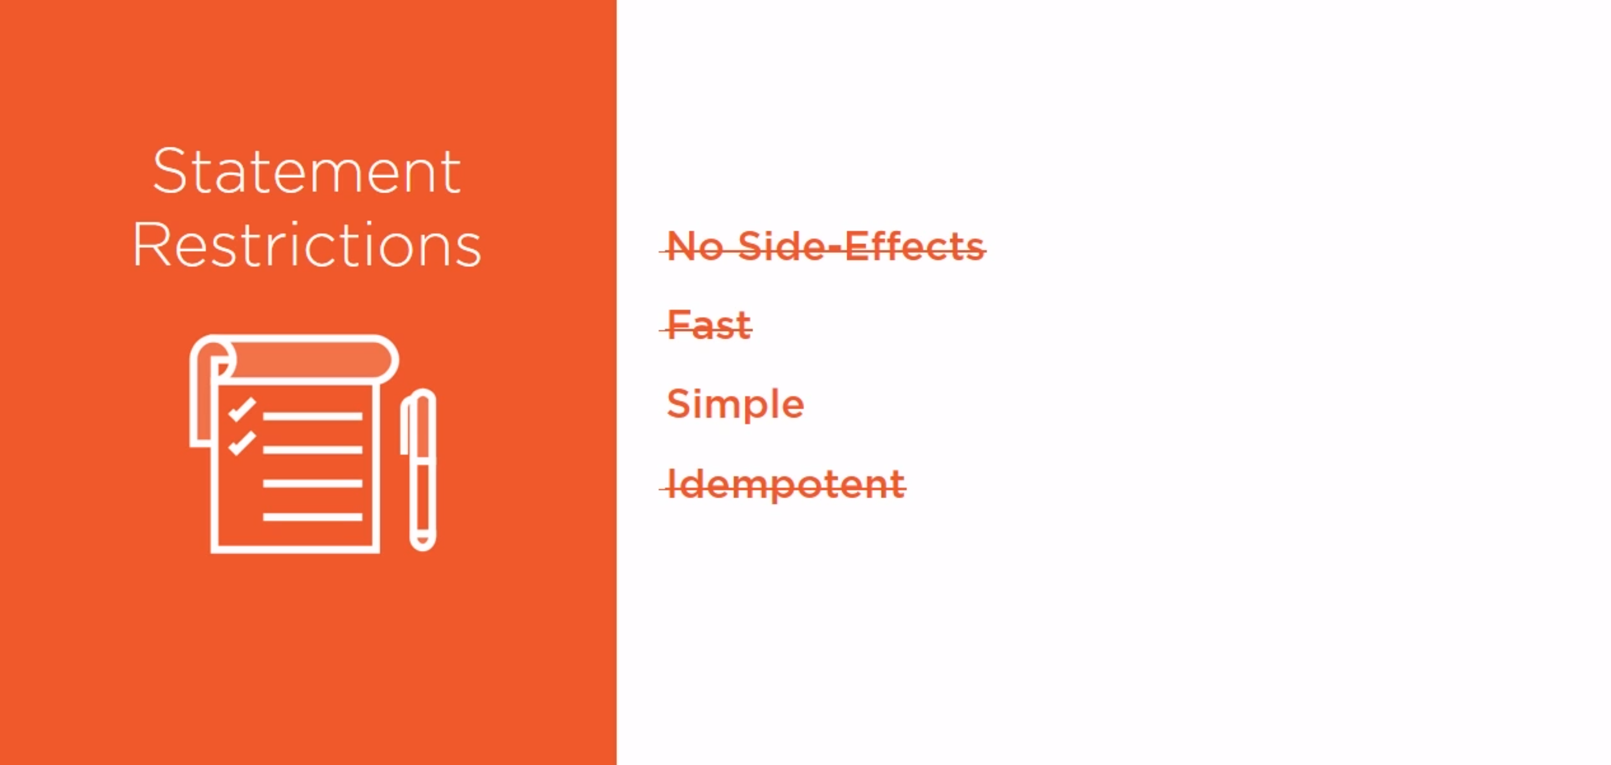
Copyright © 020 Accenture. All rights reserved.
Notes:
Idempotent: Means the value doesnot changes

Slide 14
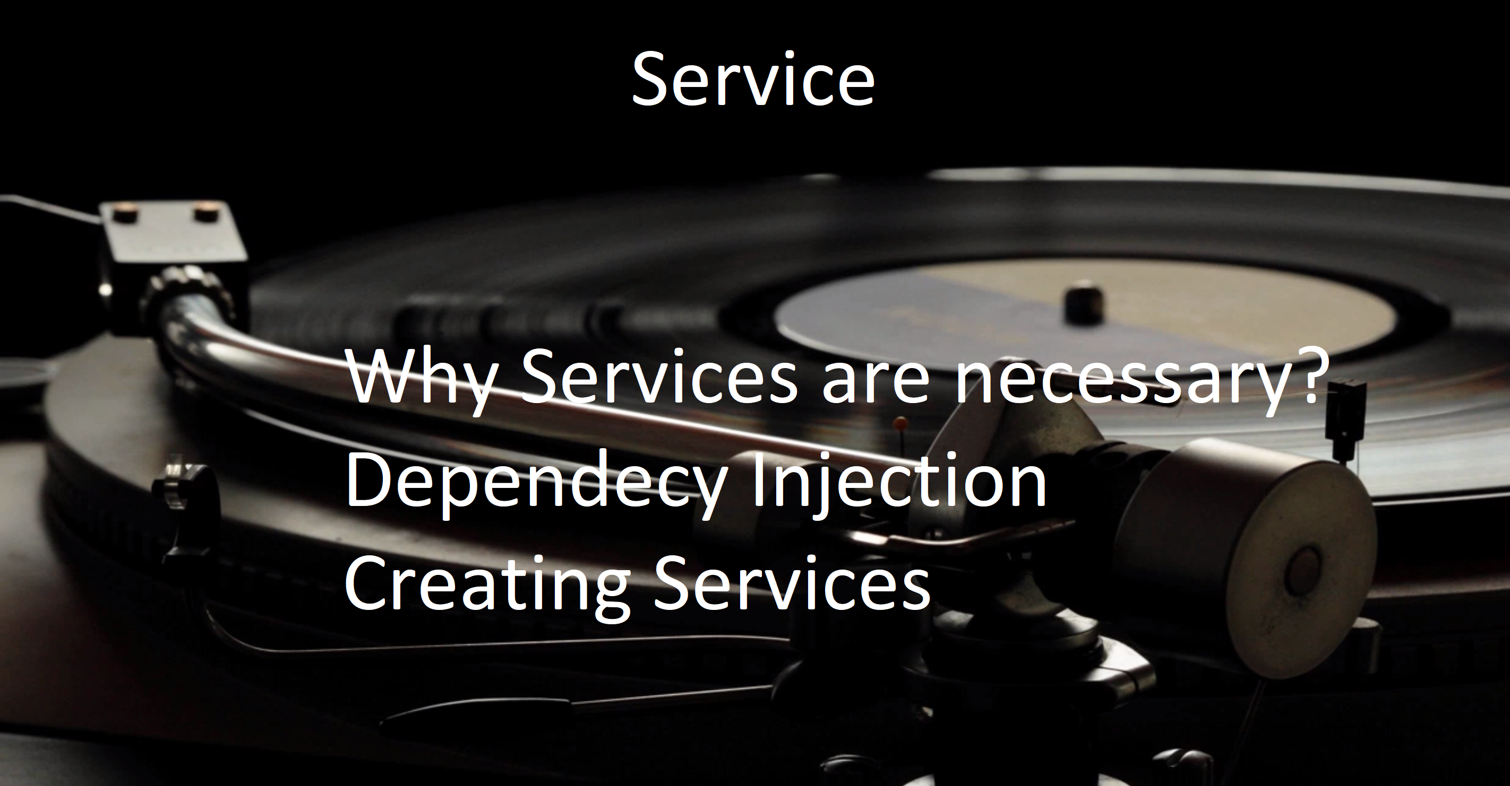

Slide 15
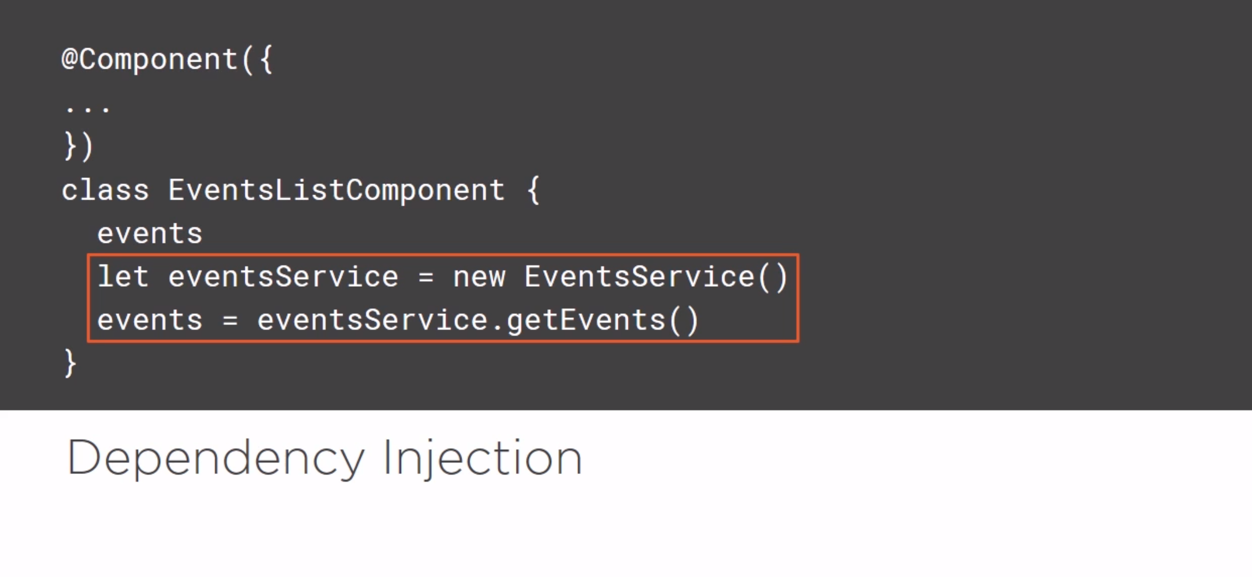
Copyright © 200 Accenture. All rights reserved.

Slide 16
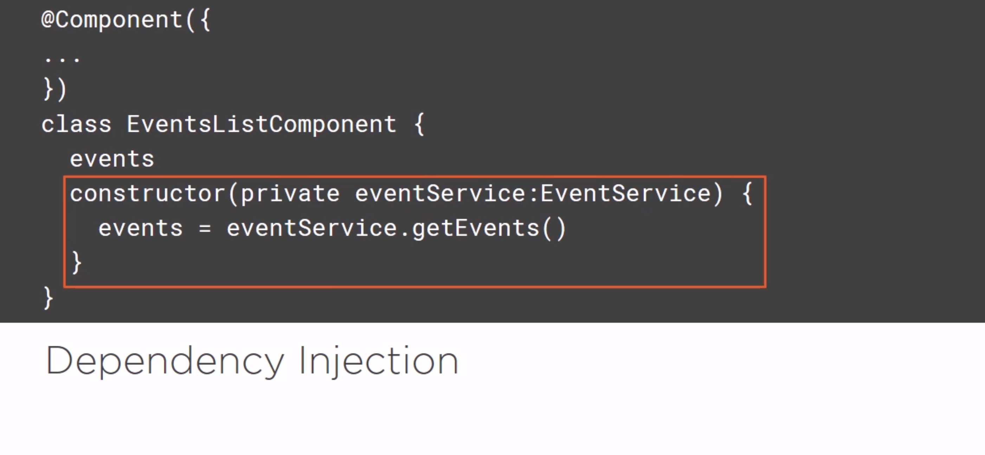

Slide 17
Quiz
Questions
1 Which of the following is correct about Angular 2 Components? A - AngularJS had a focus of Controllers but Angular 2 has changed the focus to having components over controllers. B - Components help to build the applications into many modules. C - This helps in better maintaining the application over a period of time. D - All of the above. | 2 What ECMA stands for? | 3 Who developed Typescript? | 4 Decorator that takes the single metadata object?
5 All Angular library begins with _____ | 6 How many forms of databinding available in Angular? | 7 Angular has no definition of service . True or False? | 8 A component is a directive-with-a-template. True or False
Notes:
Answers:
All of the above
European Computer manufacturing Association
Microsoft
ngModule
@angular
Four
True
True

Slide 18
Links
Official : https://angular.io/docs
https://www.pluralsight.com/paths/angular
YouTube channel : https://www.youtube.com/watch?v=KhzGSHNhnbI
https://www.edureka.co/blog/angular-tutorial/

